Slide 1


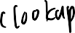
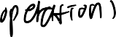



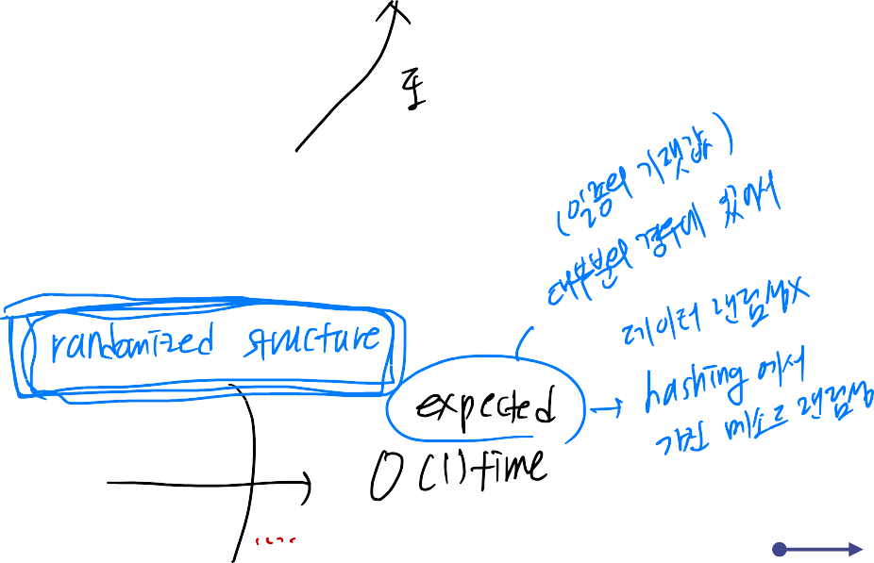
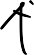
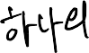
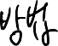
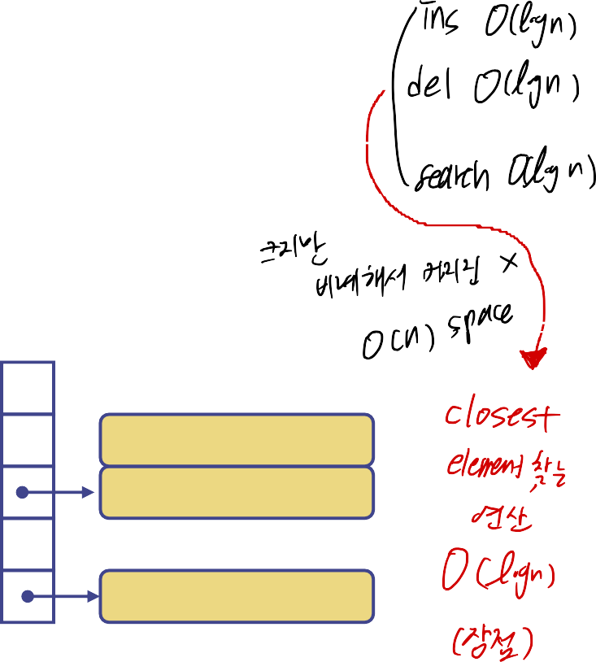


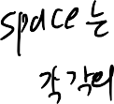
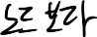
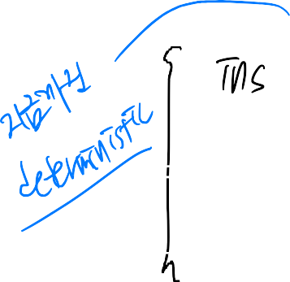
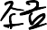
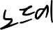
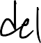

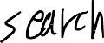



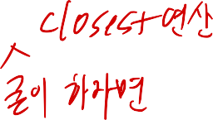


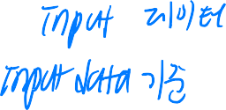







Hash Tables
0 ∅
1
025-612-0001
2
981-101-0002
3 ∅
4
451-229-0004
1

Slide 2

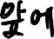
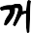
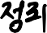
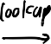
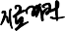
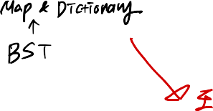
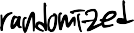

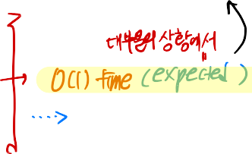

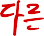


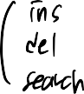
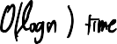

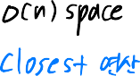



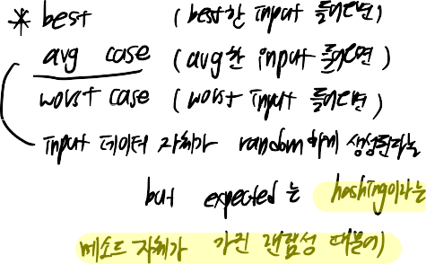
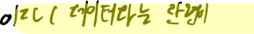
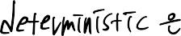

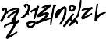
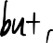


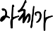
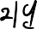

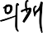

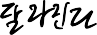
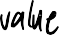
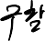
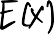
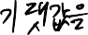
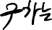
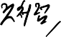
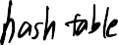
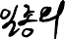
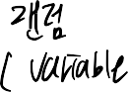
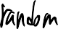
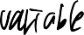
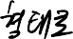
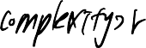




Slide 3































Slide 4















































Slide 5



Recall the Map ADT
find(k): if the map M has an entry with key k, return its
associated value; else, return null
put(k, v): insert entry (k, v) into the map M; if key k is not already in M, then return null; else, return old value associated with k
erase(k): if the map M has an entry with key k, remove it from M and return its associated value; else, return null
size(), empty()
entrySet(): return a list of the entries in M
keySet(): return a list of the keys in M
values(): return a list of the values in M
2

Slide 6







Hash Functions and Hash Tables
A hash function h maps keys of a given type to
integers in a fixed interval [0, N − 1]
Example:
h(x) = x mod N
is a hash function for integer keys
The integer h(x) is called the hash value of key x
A hash table for a given key type consists of
Hash function h
Array (called table) of size N
When implementing a map with a hash table, the goal is to store item (k, o) at index i = h(k)
3

Slide 7




Example
We design a hash table for a map storing entries as (SSN, Name), where SSN (social security number) is a nine-digit positive integer
Our hash table uses an array of size N = 10,000 and the hash function
h(x) = last four digits of x
0 ∅
1
2
3
4
025-612-0001
981-101-0002
∅
451-229-0004
…
9997
9998
9999
∅
200-751-9998
∅
4

Slide 8












Hash Functions
The hash code is applied first, and the compression function is applied next on the result, i.e.,
h(x) = h₂(h₁(x))
The goal of the hash function is to “disperse” the keys in an apparently random way
5
A hash function is usually specified as the composition of two functions:
Hash code:
h₁: keys → integers
Compression function:
h : integers → [0, N − 1]
2

Slide 9

























Hash Codes
Integer cast:
We reinterpret the bits of the key as an integer
Suitable for keys of length less than or equal to the number of bits of the integer type (e.g., byte, short, int and float in C++)
Component sum:
We partition the bits of the key into components of fixed length (e.g., 16 or 32 bits) and we sum the components (ignoring overflows)
Suitable for numeric keys of fixed length greater than or equal to the number of bits of the integer type (e.g., long and double in C++)
6

Slide 10



















Hash Codes (cont.)
Polynomial accumulation:
We partition the bits of the key into a sequence of components of fixed length (e.g., 8, 16 or 32 bits)
ª0 ª1 ^{… a}n−1
We evaluate the polynomial
p(z) = a₀ + a₁ z + a₂ z² + …… + a_{n−1}z^{n−1}
at a fixed value z, ignoring overflows
Especially suitable for strings (e.g., the choice z = 33 gives at
most 6 collisions on a set of 50,000 English words)
7

Slide 11


















Compression Functions
Division:
h₂ (y) = y mod N
The size N of the hash table is usually chosen to be a prime
The reason has to do with number theory and is beyond the scope of this course
Multiply, Add and Divide (MAD):
h₂ (y) = (ay + b) mod N
a and b are nonnegative integers such that
a mod N ≠ 0
Otherwise, every integer would map to the same value b
8

Slide 12



















































Slide 13





































Slide 14



Collision Handling
Collisions occur when different elements are mapped to the same cell
Separate Chaining: let each cell in the table point to a linked list of entries that map there
0 ∅
1
025-612-0001
2 ∅
3 ∅
4
451-229-0004
981-101-0004
Separate chaining is simple, but requires additional memory outside the table
9

Slide 15
























Slide 16








































Slide 17














Map with Separate Chaining
Delegate operations to a list-based map at each cell:
Algorithm find(k):
return A[h(k)].find(k)
Algorithm put(k,v): t = A[h(k)].put(k,v) if t = null then
n = n + 1
return t
{k is a new key}
Algorithm erase(k): t = A[h(k)].erase(k) if t R null then
n = n - 1
return t
{k was found}
10

Slide 18





















Linear Probing
Open addressing: the
Example:
h(x) = x mod 13
Insert keys 18, 41, 22, 44, 59, 32, 31,
colliding item is placed in a
different cell of the table
Linear probing: handles collisions by placing the
colliding item in the next
73, in this order
(circularly) available table cell
Each table cell inspected is
referred to as a “probe”
Colliding items lump together,
0 1 2 3 4 5 6 7 8 9 10 11 12
causing future collisions to cause a longer sequence of
18 44 59 32 22 31 73
0 1 2 3 4 5 6 7 8 9 10 11 12
11
probes
41

Slide 19



































Slide 20






























Slide 21
Search with Linear Probing
Consider a hash table A
Algorithm find(k)
that uses linear probing
i ← h(k)
find(k)
We start at cell h(k)
p ← 0
repeat
c ← A[i]
We probe consecutive
if c = ∅
locations until one of the
return null
following occurs
else if c.key () = k
An item with key k is
return c.value()
found, or
else
An empty cell is found,
i ← (i + 1) mod N
or
N cells have been
p ← p + 1
unsuccessfully probed
until p = N
return null
12

Slide 22





























Slide 23




Updates with Linear Probing
To handle insertions and deletions, we introduce a special object, called AVAILABLE, which replaces deleted elements
erase(k)
We search for an entry with key k
If such an entry (k, o) is found, we replace it with the special item AVAILABLE and we return element o
Else, we return null
put(k, o)
We throw an exception if the table is full
We start at cell h(k)
We probe consecutive cells until one of the following occurs
A cell i is found that is either empty or stores AVAILABLE, or
N cells have been unsuccessfully probed
We store (k, o) in cell i
13

Slide 24

















Double Hashing
Double hashing uses a
secondary hash function
Common choice of the
h'(k) and handles collisions
secondary hash function:
by placing an item in the
h ' (k) = q − ( k m o d q)
first available cell of the
where
series
q < N
(i + j · h'(k)) mod N
for j = O, 1, … , N − 1
q is a prime number
The secondary hash
function d(k) cannot have
The possible values for
zero values
h'(k) are
1, 2, … , q
The table size N must be a prime to allow probing of all the cells
14

Slide 25


























Slide 26















Example of Double Hashing
Consider a hash table storing integer keys that handles collision with double hashing
N = 13
h(k) = k mod 13
h'(k) = 7 − k mod 7
Insert keys 18, 41, 22, 44, 59, 32, 31, 73, in this order
k h (k ) h' (k ) Probes
18 5 3 5
41 2 1 2
22 9 6 9
44 5 5 5 10
59 7 4 7
32 6 3 6
31 5 4 5 9 0
73 8 4 8
0 1 2 3 4 5 6 7 8 9 10 11 12
31
41
18
32
59
73
22 44
0 1 2 3 4 5 6 7 8 9 10 11 12
15

Slide 27


















Rehash
Time to rehash
When the table is getting full, the operations are getting slow
For quadratic probing, insertions might fail when the table is more than half full
Load factor
open addressing: 0.5, closed addressing: 1
Rehash operation
Build another table about twice as big with a new hash function
Scan the original table, for each key, compute the new hash value and re-insert the data in the new table
16

Slide 28









Performance of Hashing
In the worst case, searches, insertions and removals on a hash table take O(n) time
The worst case occurs when all the keys inserted into the map collide
The load factor α = n/N affects the performance of a hash table
The expected running time of all the dictionary ADT operations in a hash table is O(1), as long as N is O(n)
In practice, hashing is very fast provided the load factor is not close to 100%
Applications of hash
tables:
small databases
compilers
browser caches
17

